Slide 1

Chapter 13: Project Stakeholder Management
Information Technology Project Management, Seventh Edition
Note: See the text itself for full citations.

Slide 2
Learning Objectives
Understand the importance of project stakeholder management throughout the life of a project
Discuss the process of identifying stakeholders, how to create a stakeholder register, and how to perform a stakeholder analysis

Slide 3
Importance of Project Stakeholder Management
Because stakeholder management is so important to project success, the Project Management Institute decided to create an entire knowledge area devoted to it as part of the Fifth Edition of the PMBOK® Guide in 2012
The purpose of project stakeholder management is to identify all people or organizations affected by a project, to analyze stakeholder expectations, and to effectively engage stakeholders

Slide 4
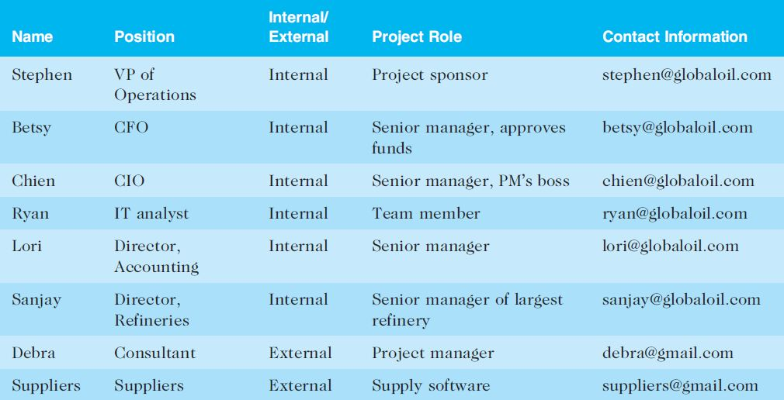
Table 13-1. Sample Stakeholder Register

Slide 5
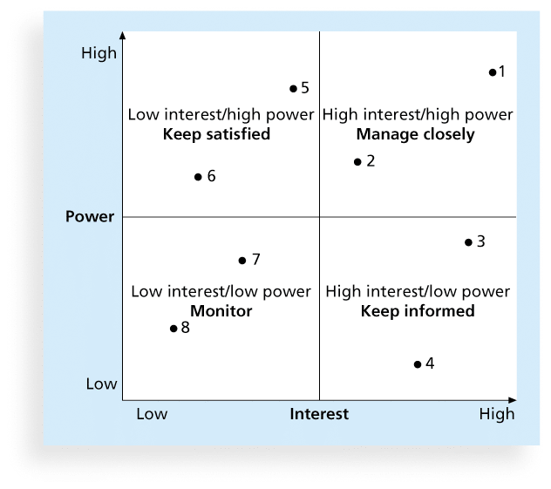
Figure 13-2. Power/Interest Grid

Slide 6
Stakeholder Engagement Levels
Unaware: Unaware of the project and its potential impacts on them
Resistant: Aware of the project yet resistant to change
Neutral: Aware of the project yet neither supportive nor resistant
Supportive: Aware of the project and supportive of change
Leading: Aware of the project

Slide 7
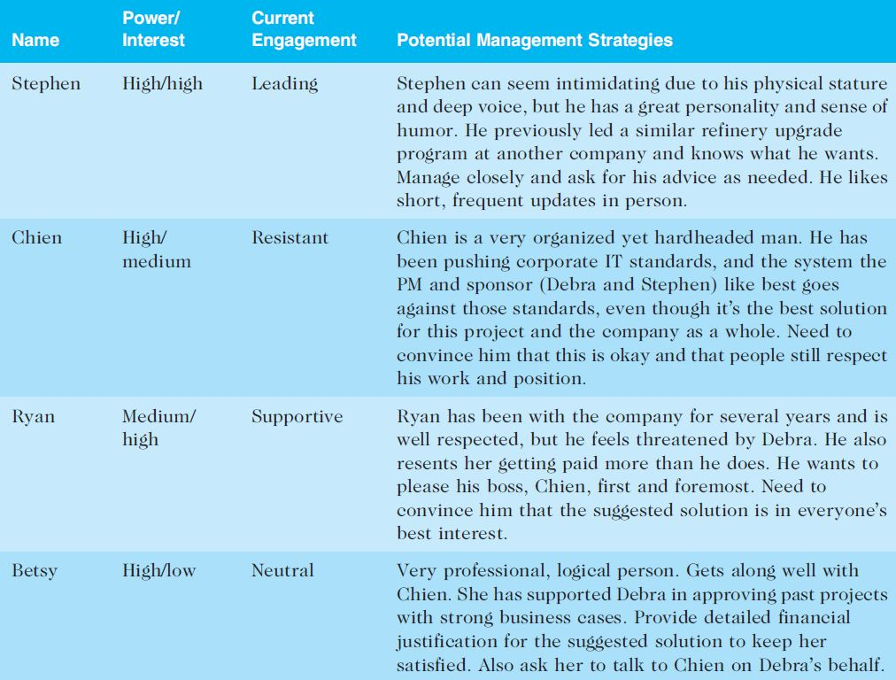
Table 13-2. Sample Stakeholder Analysis

Slide 8
Managing Stakeholder Engagement
Project success is often measured in terms of customer/sponsor satisfaction
Project sponsors often rank scope, time, and cost goals in order of importance and provide guidelines on how to balance the triple constraint
This ranking can be shown in an expectations management matrix to help clarify expectations

Slide 9
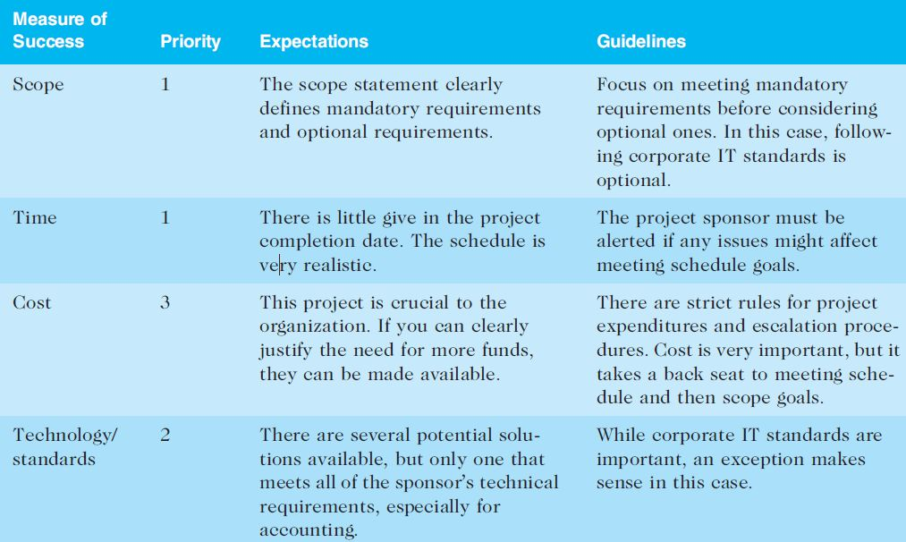
Table 13-3. Expectations Management Matrix

Slide 10
Issue Logs
Understanding the stakeholders’ expectations can help in managing issues
Issues should be documented in an issue log, a tool used to document, monitor, and track issues that need resolution
Unresolved issues can be a major source of conflict and result in stakeholder expectations not being met
Issue logs can address other knowledge areas as well

Slide 11
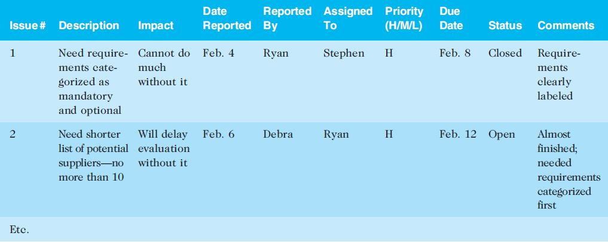
Table 13-4. Sample Issue Log

Slide 12
Ways to Control Engagement
Key stakeholders should be invited to actively participate in a kick-off meeting rather than merely attending it
The project manager should emphasize that a dialogue is expected at the meeting, including texts or whatever means of communication the stakeholders prefer. The project manager should also meet with important stakeholders before the kick-off meeting
The project schedule should include activities and deliverables related to stakeholder engagement, such as surveys, reviews, demonstrations, and sign-offs.

Slide 13
Chapter Summary
Managing stakeholders is now the tenth knowledge area in the PMBOK® Guide.
Processes include:
Identify stakeholders
Plan stakeholder management
Manage stakeholder engagement
Control stakeholder engagement

